Slide 1
Analysis of Glassdoor Reviews for S&P Global

Slide 2
Agenda
Executive Summary
Overview
Good Words about the Organization
3 Themes for Pros and Cons
What US and India Employees liked
Future Work Opportunities
Appendix

Slide 3
Executive Summary
Objectives
Identify hidden issues that might impacting employee experience.
Key Observations
Overall Employees were good with 3.3 Average overall satisfaction (out of 5).
Hot topics are Work Life Balance, Management, Work environment, People, Benefits, Brands, Leadership, Salary, Opportunities etc.
55% of the reviews are from US, India and UK employees and saw good representation from countries like – Philippines, Singapore, Pakistan etc.

Slide 4
Overview
2594
129
~ 20
30%
58%
42%
47%
73%
Reviews by former &
current employees
# Months
Average monthly reviews
Is the % of the employee from US
Of the reviews from current employees
Of the reviews from former employees
Avg. Recommender
Score
Approved Current CEO (on an Average)
Median = 3.0
Median = 3.3
Overall, Employees were more vocal from 2012 onwards, Review Count increasing, Median Avg. Overall Satisfaction ratio increased from 3.0 to 3.3
3.4
3.3
2008
2009
2010
2011
2012
2013
2014
2015
2016
2017
2018
2019
Average Overall Satisfaction
Number of reviews
54% Reviews from US, India and UK; Avg. Overall Satisfaction rate was good
Overall Employees are recommending Organization to others (with a good satisfaction level, more than 60%) , except the employees who spend 1 to 3 Yrs. in organization
489
240
US
India
UK
Philippines
Singapore
Pakistan
Argentina
France
HongKong
Others
Average overall satisfaction rating
Number of reviews
< 1 Yr
1 to 3 Yrs
3-5 Yrs
5-8 Yrs
8-10 Yrs
> 10 Yrs
Average overall satisfaction rating
Number of reviews

Slide 5
Top Pros & Cons Words about the Company
Common words in Pros and Cons with Word distribution in Pros
54.0
34.0
29.0
19.0
Work_life
work_environment
senior_management
company
work
work_culture
place_work
employees
work_home
management
people
people_work
good_people
salary
capital_iq
time
pay
job
opportunities
teams
Common words in Pros and their frequency
Common words in Cons and their frequency
work_life
good_work
good_benefits
work_environment
good_pay
good_company
work_culture
great_benefits
place_work
great_people
work_home
balance_good
work
working_environment
good_salary
nice_company
good_place
benefits_good
mcgraw_hill
flexible_work
senior_management
upper_management
company
work_life
employees
work
management
monotonous_work
good
growth_opportunities
lack
career_growth
cons
work_environment
mcgraw_hill
poor
limited
poor_management
middle_management
people

Slide 6
Slicing & Dicing Rating w.r.t. Tenure
Each segment rating difference between Current and
Former Employees w.r.t. their tenure
Each segment rating difference between Current and
Former Employees w.r.t. their tenure for US
Culture & Value
Culture & Value
Senior Leadership
Senior Leadership
Career Opportunities
Work Life Balance
Work Life Balance
Career Opportunities
Compensation & Benefits
Compensation & Benefits
< 1 Yr
1 to 3 yrs
3 to 5 yrs
5 to 8 Yrs
8 to 10 Yrs
> 10 Yrs
Less than a year
1 to 3 yrs
3 to 5 yrs
5 to 8 Yrs
8 to 10 Yrs
> 10 Yrs
Each segment rating difference between Current and
Former Employees w.r.t. their tenure for India
Senior Leadership
Culture & Value
Career Opportunities
Work Life Balance
Compensation & Benefits
< 1 Yr
1 to 3 yrs
3 to 5 yrs
5 to 8 Yrs
8 to 10 Yrs
> 10 Yrs

Slide 7
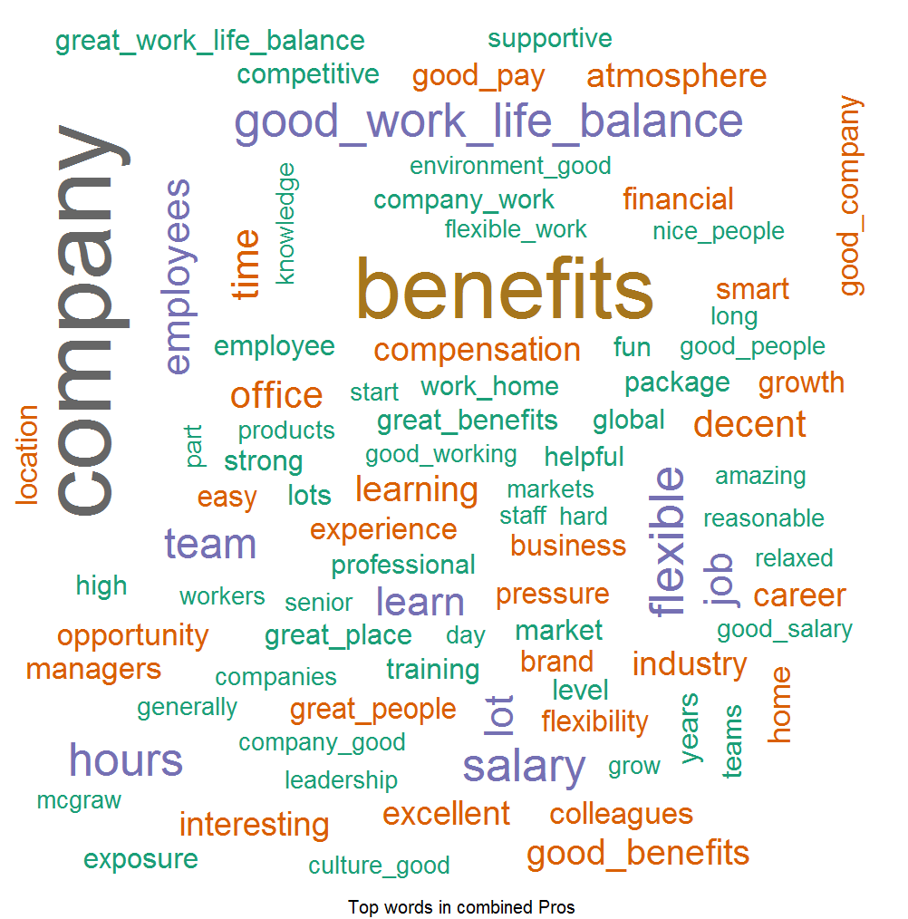
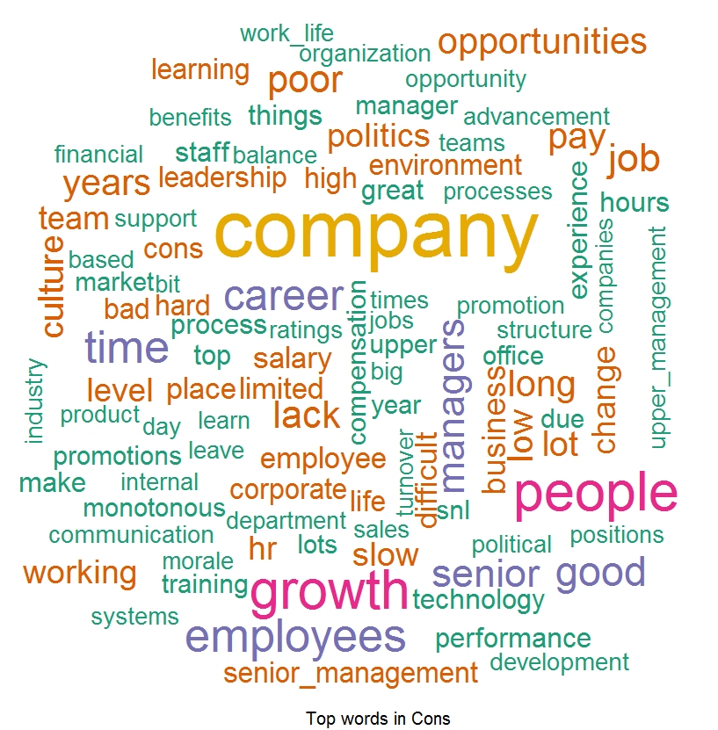
Good Words about the Company
Pros: Things which Employees liked –
According to Employees feedback, we found out that people love our Good Benefits, Good Work Life Balance, Good Company, Good People and Opportunities provided by S&P and they are spreading good words on this front.
Cons: Word List which Employees don’t like –
Feedback provided by the Employees they found out to difficulty to cope up with Opportunities, Work Life, senior management, HR Processes , Monotonous Work , Growth , Promotions and Layoffs and this can be improved.

Slide 8
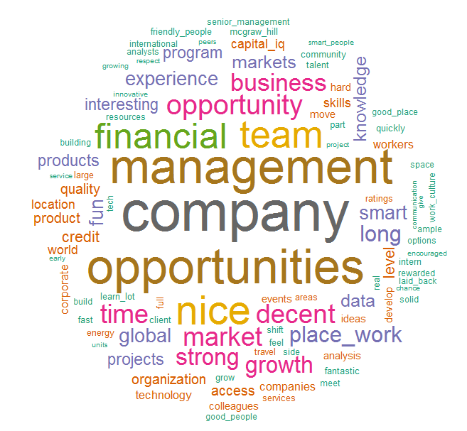
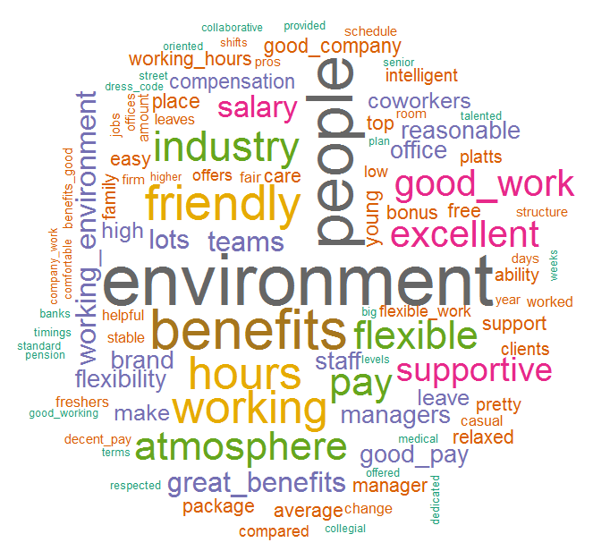
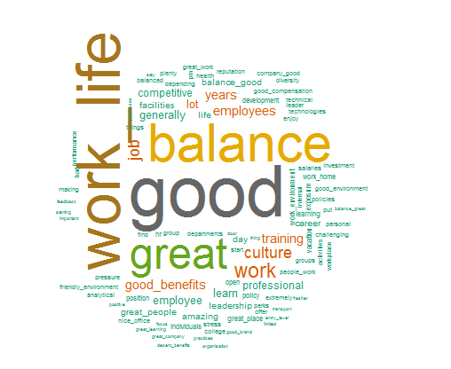
Top 3 Themes – For Pros
We identified three themes, based on word occurrence in collection of positive comments and closeness from other words (Statistically), Which employees liked
Theme 1: Respect to Personal Life
(Work Life balance, Work and Benefits)
Theme 2: Financial Oriented (Benefits, Pay, Salary, Flexibility, Standard Pension etc.)
Theme 3: Equity Brand
( Company, Brand, Opportunity, Management, Global Company etc.)

Slide 9
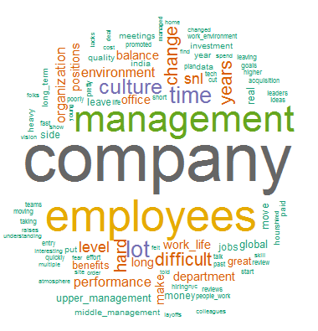
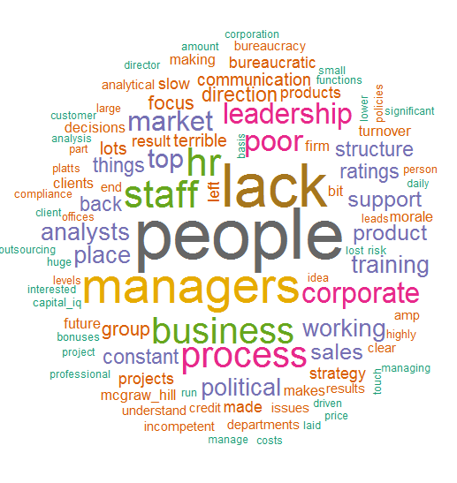
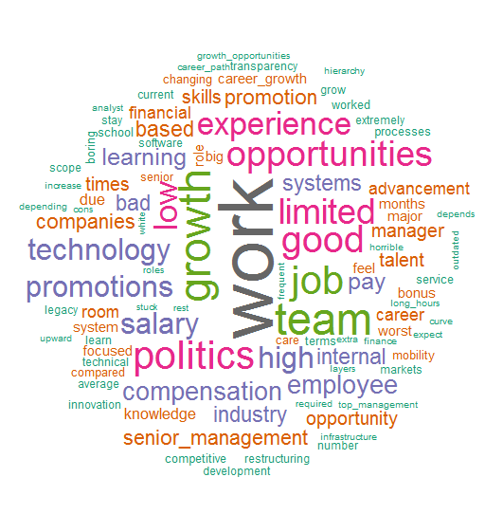
Top 3 Themes – For Cons
We identified three themes based on word occurrence in collection of negative comments and closeness from other words (Statistically), Which employees didn’t liked
Theme 1: Upper Management
(Management, Company, Employees, time etc.)
Theme 2: Immediate Team and Process
(People, Managers, Process etc.)
Theme 3: Growth
(Work, Growth, Opportunities, Promotions, Compensation, Politics etc.)

Slide 10
Top Keywords with Star Ratings (overall)
Top keywords in 5 Star ratings
(In Pros)
Work Life Balance
Work Culture
Work Environment
Good Pay
Great Place to work
(In Cons)
Work
Management
Top keywords in 4 Star ratings–
(In Pros)
Work Life Balance
Good Company to Work
Good Salary
Good Benefits
Work environment
(In Cons)
Work
Employees
Management
Opportunities
Growth
5 Start
4 Star
3 Star
2 Star
1 Star
Top keywords in 3 Star ratings–
(In Pros)
Work Life Balance
Good Pay
Good work
Work from home
Good benefits
(In Cons)
Upper Management
Work life balance
Growth opportunity
Monotonous work
Top keywords in 2 Star ratings–
(In Pros)
Work Life Balance
Good Benefits
Good Pay
(In Cons)
Management
Work
Growth
Employees
Work Life Balance
Top keywords in 1 Star ratings–
(In Pros)
Work Life Balance
Good Benefits
Good Pay
(In Cons)
Management
Growth
Work
People manager
Work life balance

Slide 11
Top Keywords with Star Ratings (Career Opportunity)
Top keywords in 5 Star ratings
(In Pros)
Work Life Balance
Good work
Work Environment
Work culture
Management
Top keywords in 4 Star ratings–
(In Pros)
Work Life balance
Work Culture
Work Environment
Good Pay
Good environment
5 Start
4 Star
3 Star
2 Star
1 Star
Top keywords in 3 Star ratings–
(In Pros)
Work Life Balance
Work Environment
Good Work
Good Company
Work culture
Top keywords in 2 Star ratings–
(In Pros)
Work Life Balance
Good Benefits
Good Pay
Good Work
Good Company
Top keywords in 1 Star ratings–
(In Pros)
Work Life Balance
Good Benefits
Good Pay
Work from home
Work environment

Slide 12
Top Keywords with Star Ratings (Compensation & Benefits)
Top keywords in 5 Star ratings
(In Pros)
Work Life Balance
Work Environment
Great benefits
Good work
Good Pay
Top keywords in 4 Star ratings–
(In Pros)
Work Life balance
Good pay
Good Benefits
Good work
Work environment
5 Start
4 Star
3 Star
2 Star
1 Star
Top keywords in 3 Star ratings–
(In Pros)
Work Life Balance
Work Environment
Good Work
Good Company
Good Benefits
Top keywords in 2 Star ratings–
(In Pros)
Work Life Balance
Good Benefits
Good Company
Work environment
Good Work
Top keywords in 1 Star ratings–
(In Pros)
Work Life Balance
Good work
Good Benefits
Work environment
Good culture

Slide 13
Top Keywords with Star Ratings (Culture and Value)
Top keywords in 5 Star ratings
(In Pros)
Work life balance
Good work
Work environment
Work culture
Good place to work
Top keywords in 4 Star ratings–
(In Pros)
Work Life balance
Good work culture
Good pay
Work environment
Good benefits
5 Start
4 Star
3 Star
2 Star
1 Star
Top keywords in 3 Star ratings–
(In Pros)
Work Life Balance
Good Benefits
Good Pay
Good Work environment
Great people
Top keywords in 2 Star ratings–
(In Pros)
Work Life Balance
Good pay
Good Benefits
Flexible working hours
Great work
Top keywords in 1 Star ratings–
(In Pros)
Work Life Balance
Good work
Good Benefits
Good place to work
Work from home

Slide 14
Analysis on Advise to Management
We used NLP methods to score each comments to identify comment is given in positive sense or negative sense and the comments are Public specific or person sepcific
Top keywords in Advise to Management –
(In Positive)
Employees
Senior Management
People
Good work
Focus on Market
Management
Time
Top keywords in Advise to Management –
(In Negative)
Senior
Quality work
Mid level management
Sales
Culture of company
Lower level impact
Invest technology
Top keywords in Advise to Management –
(Public specific)
Good Work
Good People
Senior Management
Employees
Management team
Top keywords in Advise to Management –
(Person specific)
Employees
Senior Management
Focus
Middle Management
Good People

Slide 15
What US and India Employees liked
What US Employees liked –
Work Life Balance
Good Pay
Good Culture
Great Benefits
Interesting Work
Work Hours
What US Employees didn’t liked –
Growth
Work
Politics
Leadership
Opportunities
Promotions
What India Employees liked –
Work Life Balance
Good Working Environment
Good Culture
Less Work Pressure
Transport Facility
Good Pay
What India Employees didn’t liked –
Not Enough Opportunities
Slow Career / Growth opportunity
Promotion
Monotonous work
Training
Night Shift

Slide 16
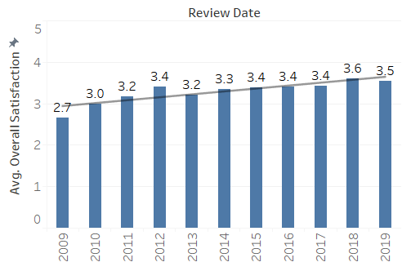
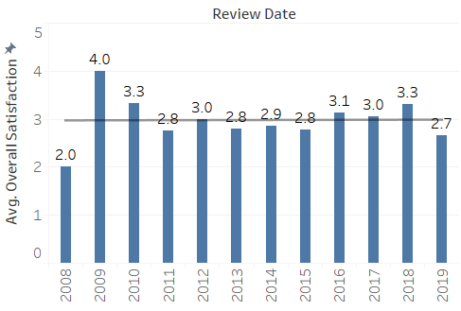
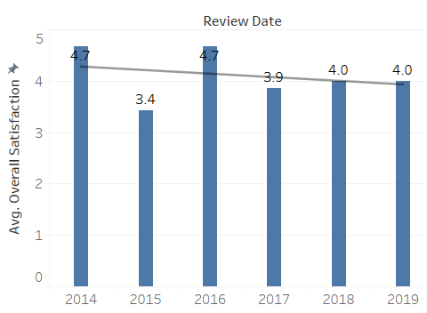
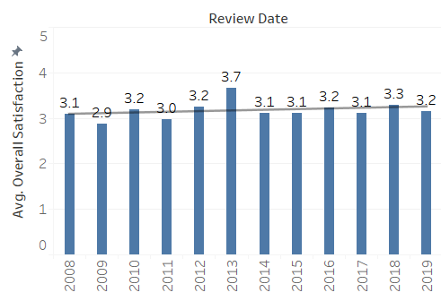
Overall satisfaction for all Division
Avg. Overall Satisfaction in MI
Avg. Overall Satisfaction in Platts
Avg. Overall Satisfaction in DJI
Avg. Overall Satisfaction in Ratings
* For Employees over all satisfaction MI and Ratings divisions saw an increase, Platts shows a constant and DJI shows negative trend.

Slide 17
What Employees liked (based on each division)
What MI Employees liked –
Work Life Balance
Good Work Culture
Great Benefits
Good Work
Good People
Opportunities
What Platts Employees liked –
Good Benefits
Good Work life balance
Good Work
Smart People
Flexible timings
What DJI Employees liked –
Good Benefits
Good Work Life Balance
Good Company
Good Interns
Professional People
Globally renown company
What Ratings Employees liked –
Good Benefits
Good Work Life Balance
Good Company
Learning
Interesting Work
Work From Home
Working hours

Slide 18
What Employees didn’t liked (based on each division)
What MI Employees didn’t liked –
Growth
Lack of Training
Monotonous Work
Bad Managers
Promotions
Salary
What Platts Employees didn’t liked –
Long Hours
Political Manager
Career Progression
Leadership
Salary
What DJI Employees didn’t liked –
Politics
Protected Management
Opportunities
Inequality in pay
Squeaky wheel
What Ratings Employees didn’t liked –
Promotions
Process
Less training
Bonus
Salary
Analytical job without Analytical work

Slide 19
Future Work Opportunities
Analysis of Exit surveys ( VIBE data ) and check “What Employees are talking”. Based on outcome of this analysis, we can measure similarities between both feedbacks.
Analysis of interview / recruitment experience.
EVP analysis and include different Social media channels like – S&P Global Facebook Page, Twitter Feeds etc.
Similar analysis can be performed on the few topics like – onboarding, Movement, orientation, First 30 days experience etc.

Slide 20
Appendix

Slide 21
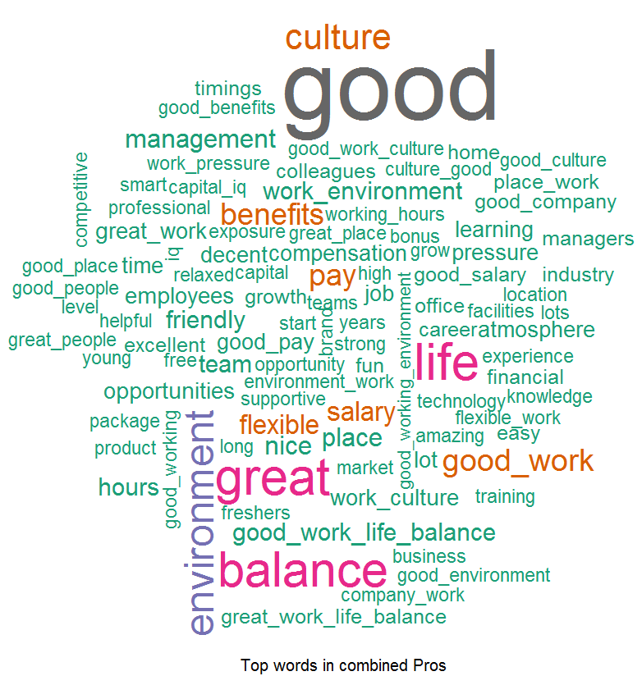
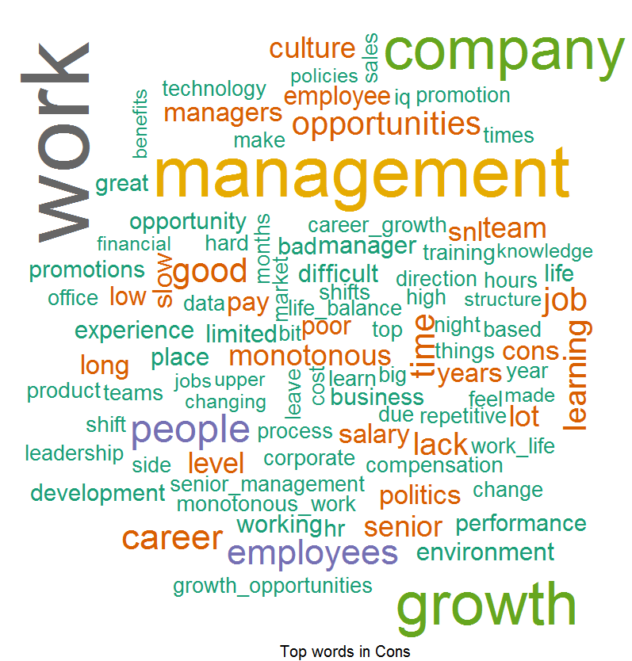
Good Words about the MI
Pros: Things which Employees liked –
According to Employees feedback, we found out that people love our Good Benefits, Good Work Life Balance, Good Work Culture, Good People and Opportunities provided by S&P and they are spreading good words on this front.
Cons: Word List which Employees don’t like –
Feedback provided by the Employees they found out to difficulty to cope up with Opportunities, Growth, Lack of Training, Monotonous Work, Bad Manager, Promotions and Salary and this can be improved.

Slide 22
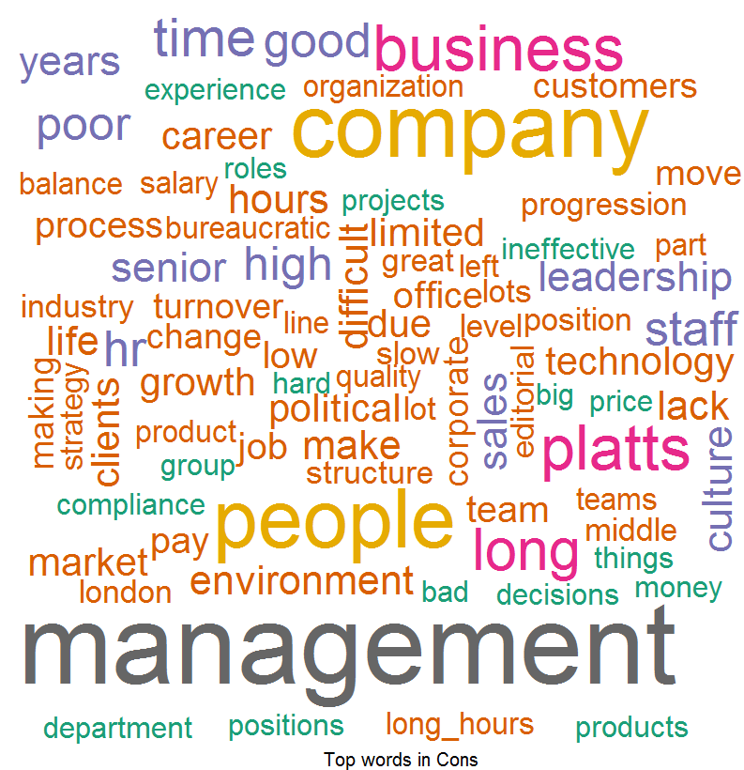
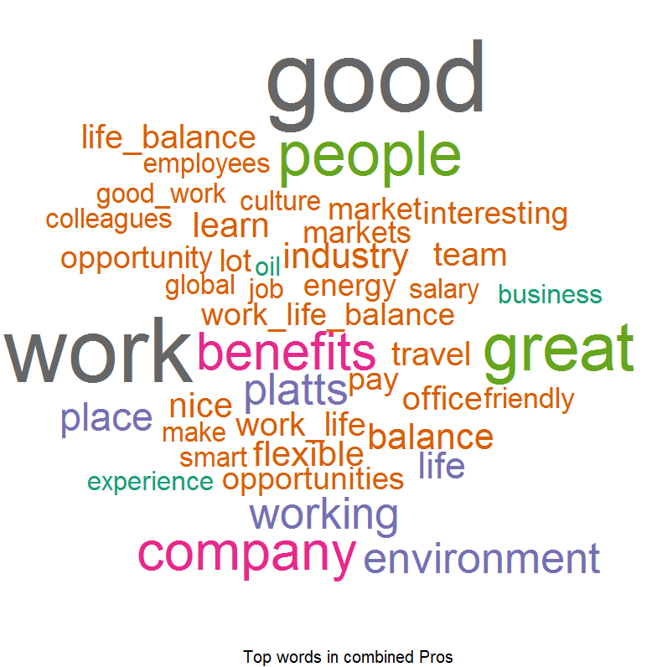
Good Words about the Platts
Pros: Things which Employees liked –
According to Employees feedback, we found out that people love our Good Benefits, Good Work Life Balance, Good Work, Smart People and Flexible time provided by S&P and they are spreading good words on this front.
Cons: Word List which Employees don’t like –
Feedback provided by the Employees they found out to difficulty to cope up with Long Hours, Political Managers, Career Progression and Salary and this can be improved.

Slide 23
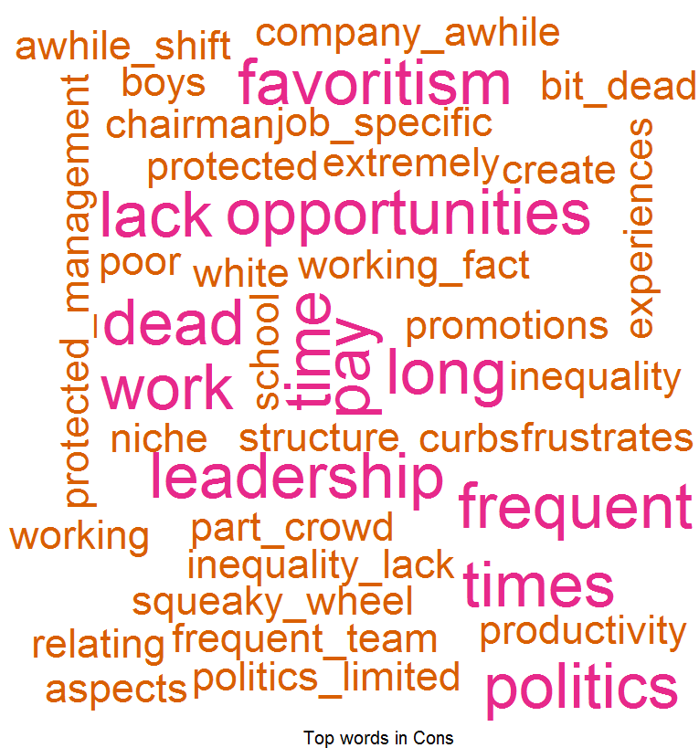
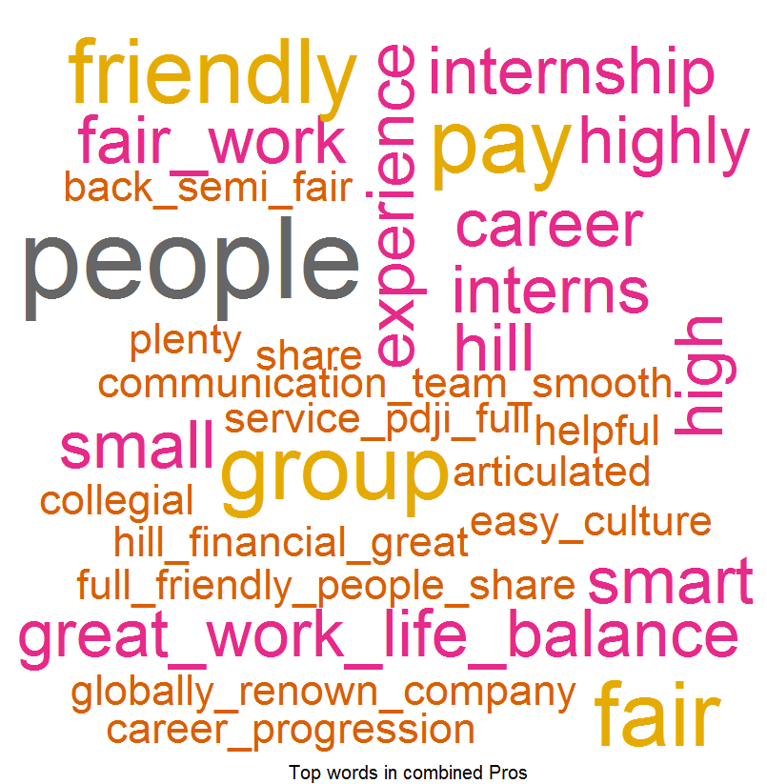
Good Words about the DJI
Pros: Things which Employees liked –
According to Employees feedback, we found out that people love our Good Benefits, Good Work Life Balance, Good company, Good Interns, Professional Peoples, Good Internship and Globally renown company provided by S&P and they are spreading good words on this front.
Cons: Word List which Employees don’t like –
Feedback provided by the Employees they found out to difficulty to cope up with Politics, Protected Management, Opportunities, Promotions, Squeaky wheel and Inequality in pay and this can be improved.

Slide 24
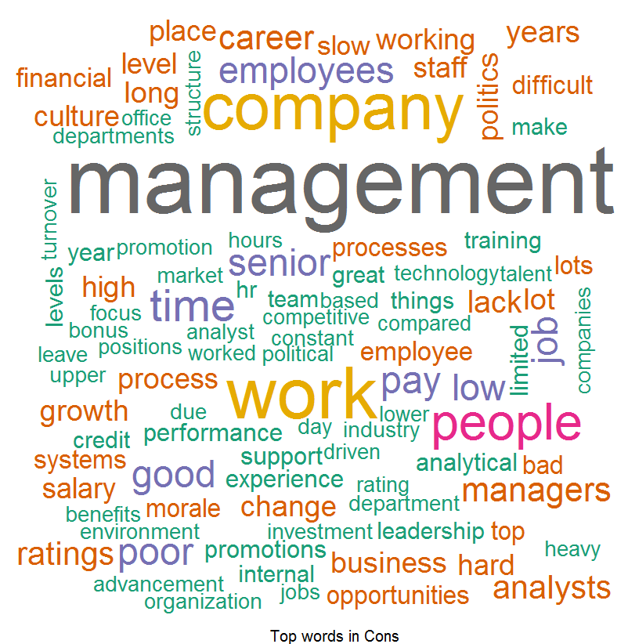
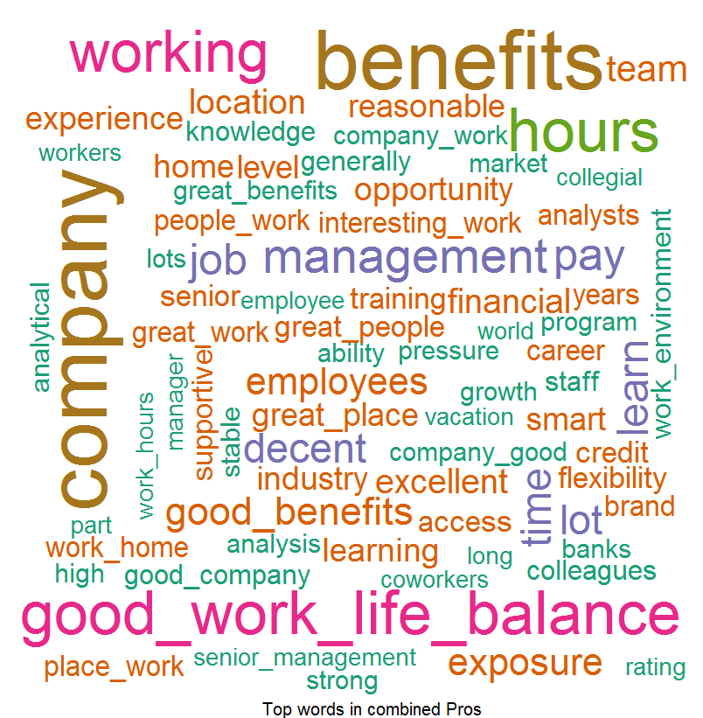
Good Words about the Ratings
Pros: Things which Employees liked –
According to Employees feedback, we found out that people love our Good Benefits, Good Work Life Balance, Good company, Learning, Interesting Work, Work from Home, Working Hours and Office Location provided by S&P and they are spreading good words on this front.
Cons: Word List which Employees don’t like –
Feedback provided by the Employees they found out to difficulty to cope up with Promotions, Processes, Less Trainings, Bonus, Salary and Analytical Job without Analytical work and this can be improved.

Slide 25
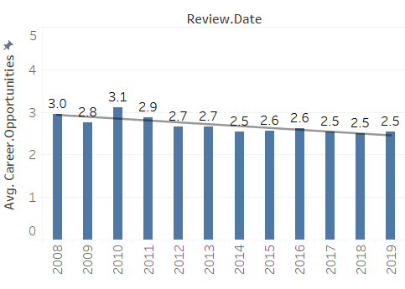
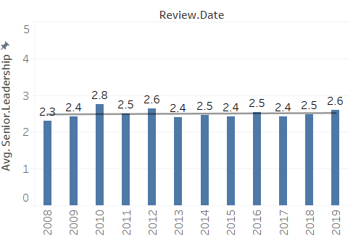
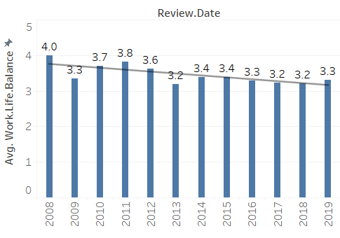
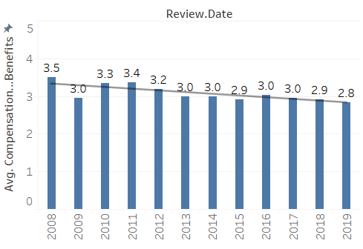
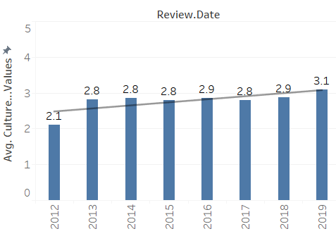
Overview – For 5 Subsections (Overall)
Avg. Career Opportunity over the Years
Avg. Senior Leadership over the Years
Avg. Work Life balance over the Years
Avg. Comp & Benefits over the Years
Avg. Culture & Value over the Years

Slide 26
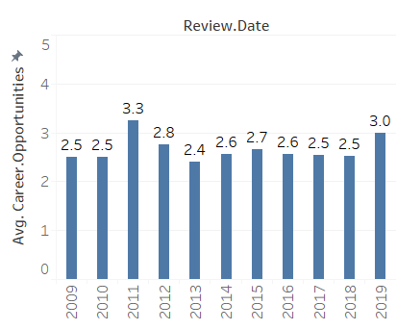
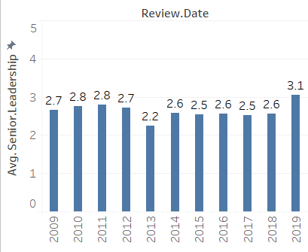
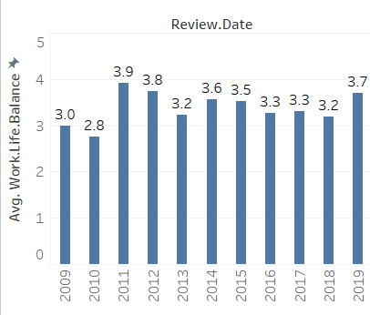
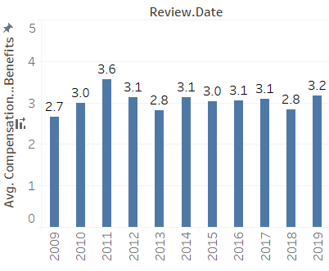
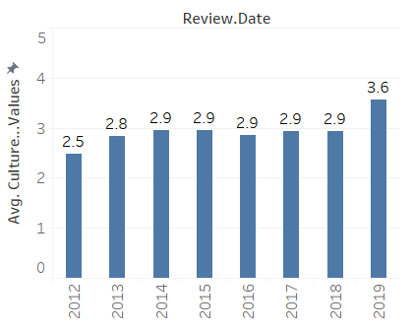
Overview – For S&P MI
Avg. Career Opportunity over the Years
Avg. Senior Leadership over the Years
Avg. Work Life balance over the Years
Avg. Comp & Benefits over the Years
Avg. Culture & Value over the Years

Slide 27
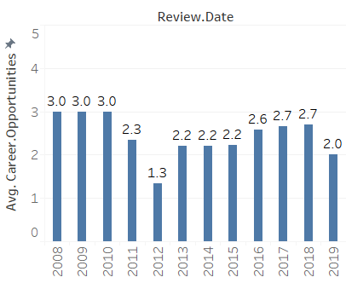
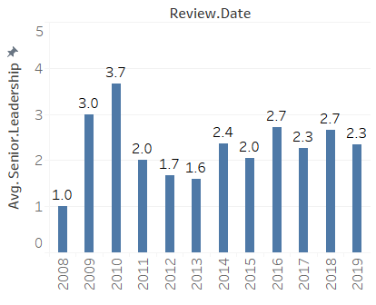
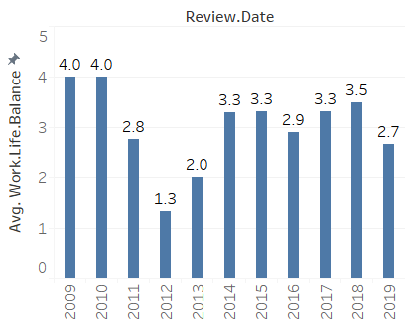
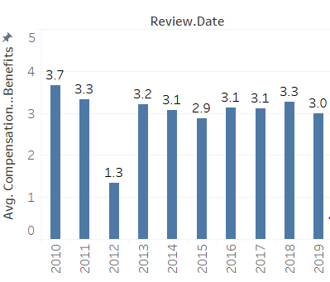
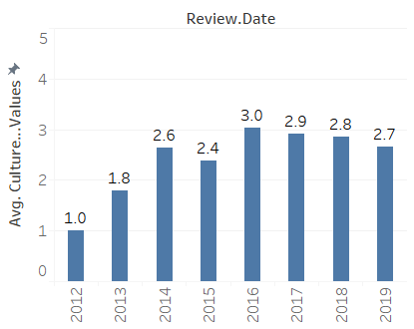
Overview – For S&P Platts
Avg. Career Opportunity over the Years
Avg. Senior Leadership over the Years
Avg. Work Life balance over the Years
Avg. Comp & Benefits over the Years
Avg. Culture & Value over the Years

Slide 28
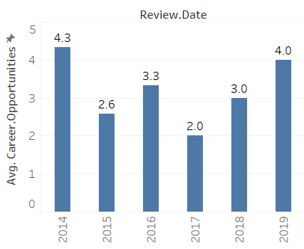
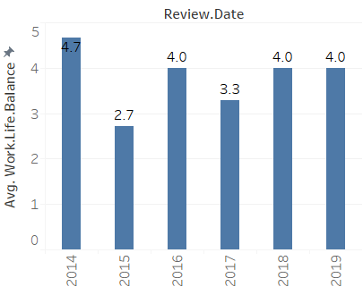
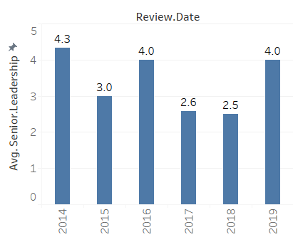
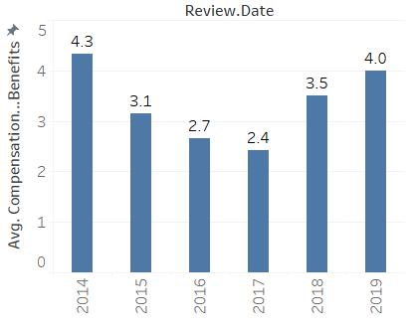
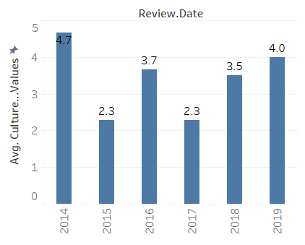
Overview – For S&P DJI
Avg. Career Opportunity over the Years
Avg. Senior Leadership over the Years
Avg. Work Life balance over the Years
Avg. Comp & Benefits over the Years
Avg. Culture & Value over the Years

Slide 29
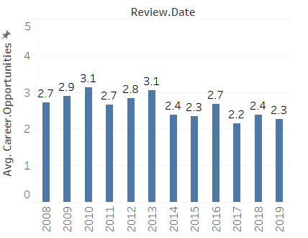
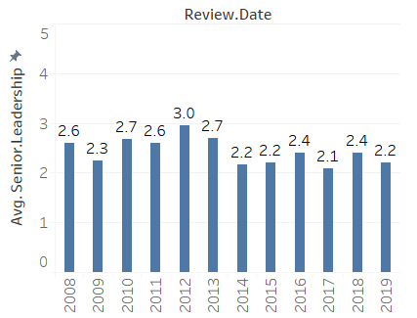
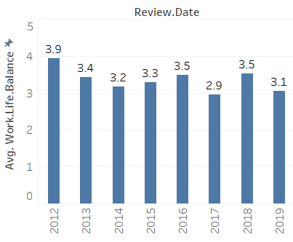
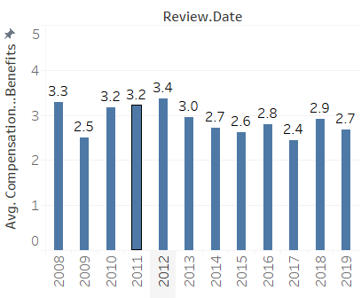
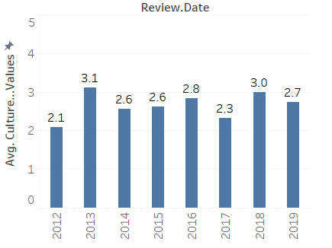
Overview – For S&P Ratings
Avg. Career Opportunity over the Years
Avg. Senior Leadership over the Years
Avg. Work Life balance over the Years
Avg. Comp & Benefits over the Years
Avg. Culture & Value over the Years

Slide 30
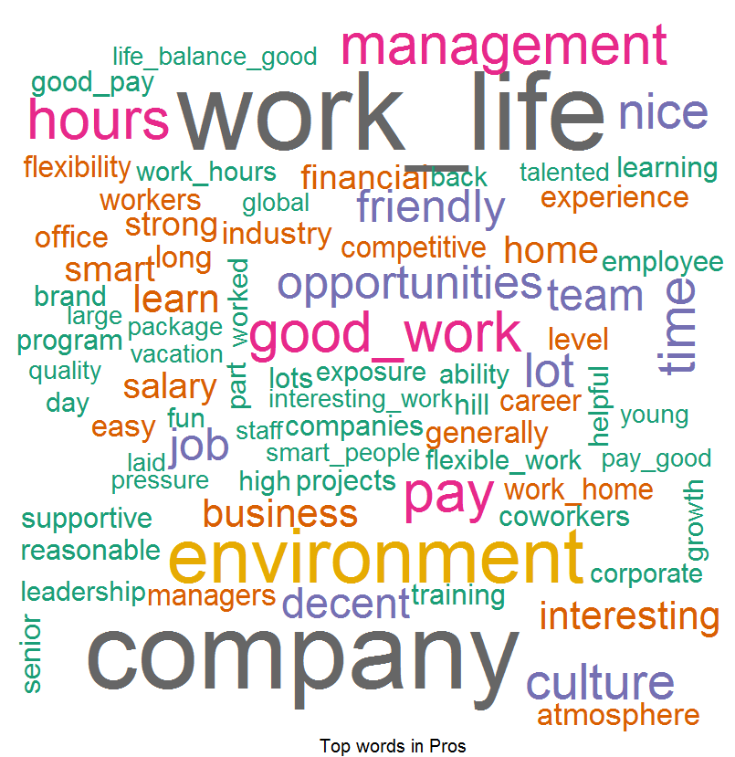
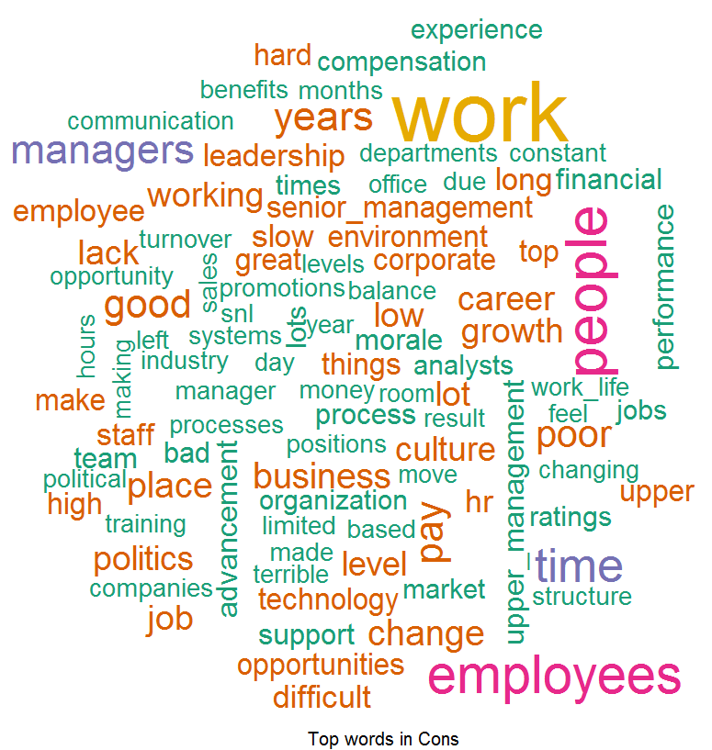
Word Cloud For US
Word Cloud for Pros
Word Cloud for Cons
Good Words List –
Work Life Balance
Good Pay
Good Culture
Great Benefits
Interesting Work
Work Hours
Word List which people don’t like –
Growth
Work
Politics
Leadership
Opportunities
Promotions

Slide 31
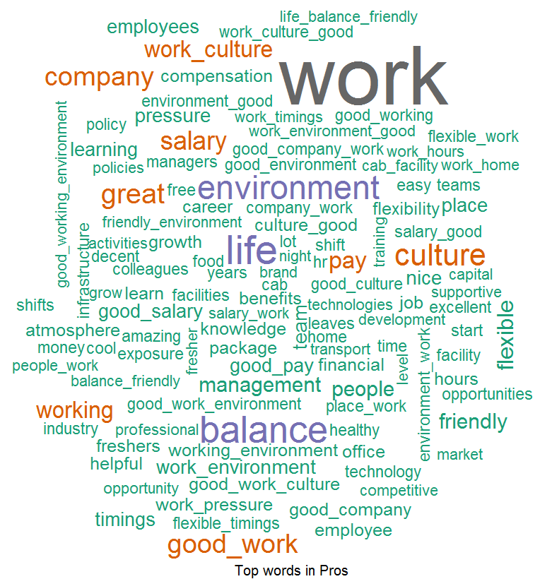
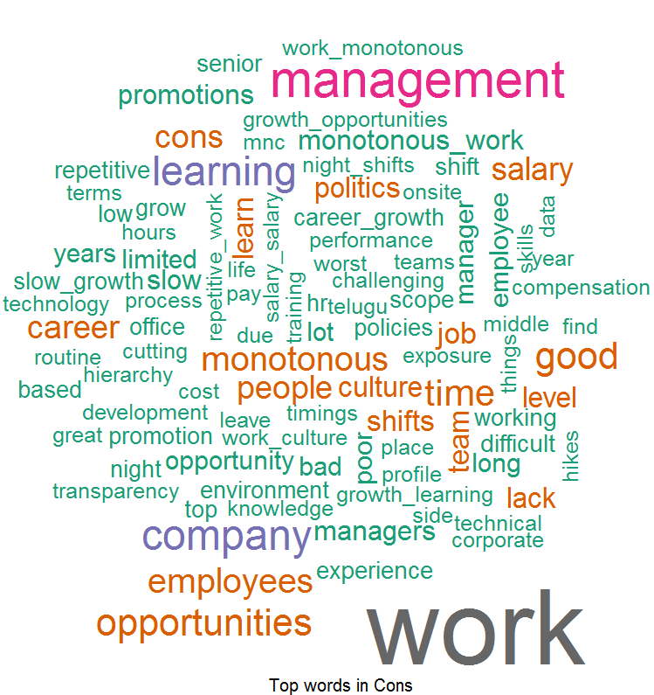
Word Cloud For India
Word Cloud for Pros
Word Cloud for Cons
Good Words List –
Work Life Balance
Good Working Environment
Good Culture
Less Work Pressure
Transport Facility
Good Pay
Word List which people don’t like –
Not Enough Opportunities
Slow Career / Growth opportunity
Promotion
Monotonous work
Training
Night Shift

Slide 32
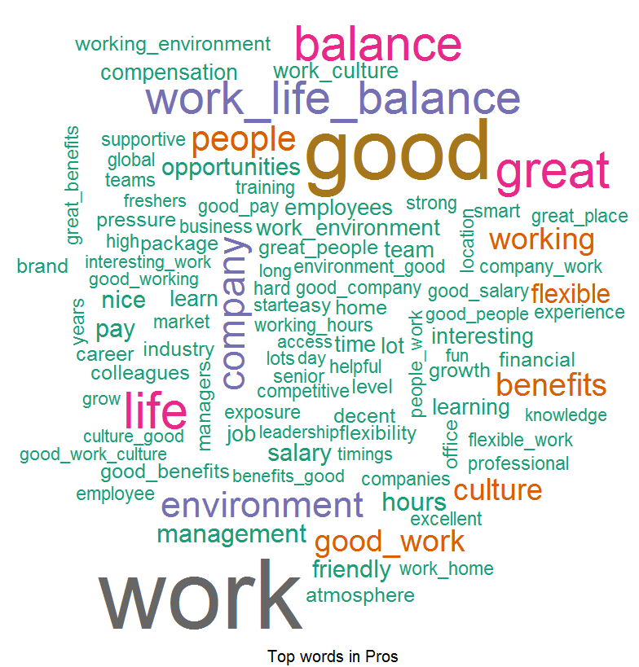

Word Cloud For Current Employees
Word Cloud for Pros
Word Cloud for Cons
Good Words List –
Work Life Balance
Good Work
Good Work Culture
Good Benefits
Flexible Time
Work From Home
Word List which people don’t like –
Career Growth opportunities
Opportunities
Not Enough Learning
Training
Politics

Slide 33


Word Cloud For Former Employees
Word Cloud for Pros
Word Cloud for Cons
Good Words List –
Work Life Balance
Work Environment
Good Benefits
Flexibility
Great Company
Word List which people don’t like –
Growth
Culture
Politics
Opportunity, Promotion
Learning / Training

